Slide 1
IBM University Engagement Project Submission
“Exploring the Power of Agentic AI with IBM Granite and IBM Bob”

Slide 2

Project Tile – [Research Agent]
Domain of Project – [Education]
Student Name | Recent Passport Photo | Email ID | Mobile number [WhatsApp]
Vivek Kumar |  | vk431152@gmail.com | 6205606989
Recommended font style and size:
Font Style: Arial
Font Size (Heading): 28
Font Size (Content): 20

Slide 3
Problem Statement -
Problem Statement : Research Agent
The Challenge
A Research Agent is an AI system designed to assist with academic and scientific research tasks. It can autonomously search for literature, summarize papers, and organize references. Using natural language processing, it understands research questions and retrieves relevant information. The agent can generate reports, suggest hypotheses, and even draft sections of research papers. It saves time by automating repetitive tasks like citation management and data extraction. Research Agents enhance efficiency, accuracy, and innovation in both academic and industrial R&D.
The Objective
Build an AI-powered Research Agent that automates academic and scientific research workflows for researchers, students, and R&D professionals. The solution should:
Autonomous Literature Discovery – Search for relevant academic papers, scientific literature, and scholarly sources based on natural language research questions.
Smart Summarization & Extraction – Extract key data points, summarize papers, and process text efficiently to retrieve accurate information.
Reference & Citation Management – Organize references, handle citations, and eliminate repetitive manual tracking tasks.
Hypothesis Generation & Reporting – Synthesize findings to generate comprehensive research reports, suggest novel hypotheses, and assist in drafting paper sections.

Slide 4
Proposed Solution -
The proposed solution is an autonomous academic and scientific R&D assistant built using IBM Bob, IBM watsonx Orchestrate, and IBM watsonx Granite Models to provide end-to-end intelligent research support. The system addresses the core challenges faced by researchers — information overload, time-consuming literature reviews, inconsistent citation formatting, and the difficulty of synthesizing findings across hundreds of papers — through a modular, agentic architecture.
Core Architecture
At its heart, the solution uses a multi-tool agentic pipeline powered by the react_core reasoning style in IBM watsonx Orchestrate. The agent autonomously decomposes a natural-language research request into a sequence of tool calls — searching databases, summarizing papers, formatting references, and drafting reports — without requiring any manual step-by-step instruction from the user.
The system integrates a federated literature search layer that queries three independent academic databases simultaneously:
Semantic Scholar — for citation-rich, cross-domain academic papers
arXiv — for cutting-edge preprints in AI, physics, mathematics, and computer science
CrossRef — for peer-reviewed, DOI-indexed journal articles
Search results are returned as structured metadata (title, authors, year, abstract, DOI, citation count) and fed directly into downstream tools without manual data handling.

Slide 5
Technology Used
IBM Bob platform -For designing and orchestrating multi-agent workflows visually
IBM Grainte model - ibm-granite-4-h-small – For natural language understanding, reasoning, and personalization.
IBM Cloud – It provides the infrastructure to build, deploy, and scale the Research Agent efficiently. IBM Cloud enables a reliable, secure, and scalable environment for deploying the Nutrition Agent.
IBM watsonx Orchestrate - For agent orchestration and tool management.
IBM Watsonx.ai - For model deployment, embeddings, and AI governance.
RAG — Retrieval-Augmented Generation - For grounding answers in real academic data.

Slide 6
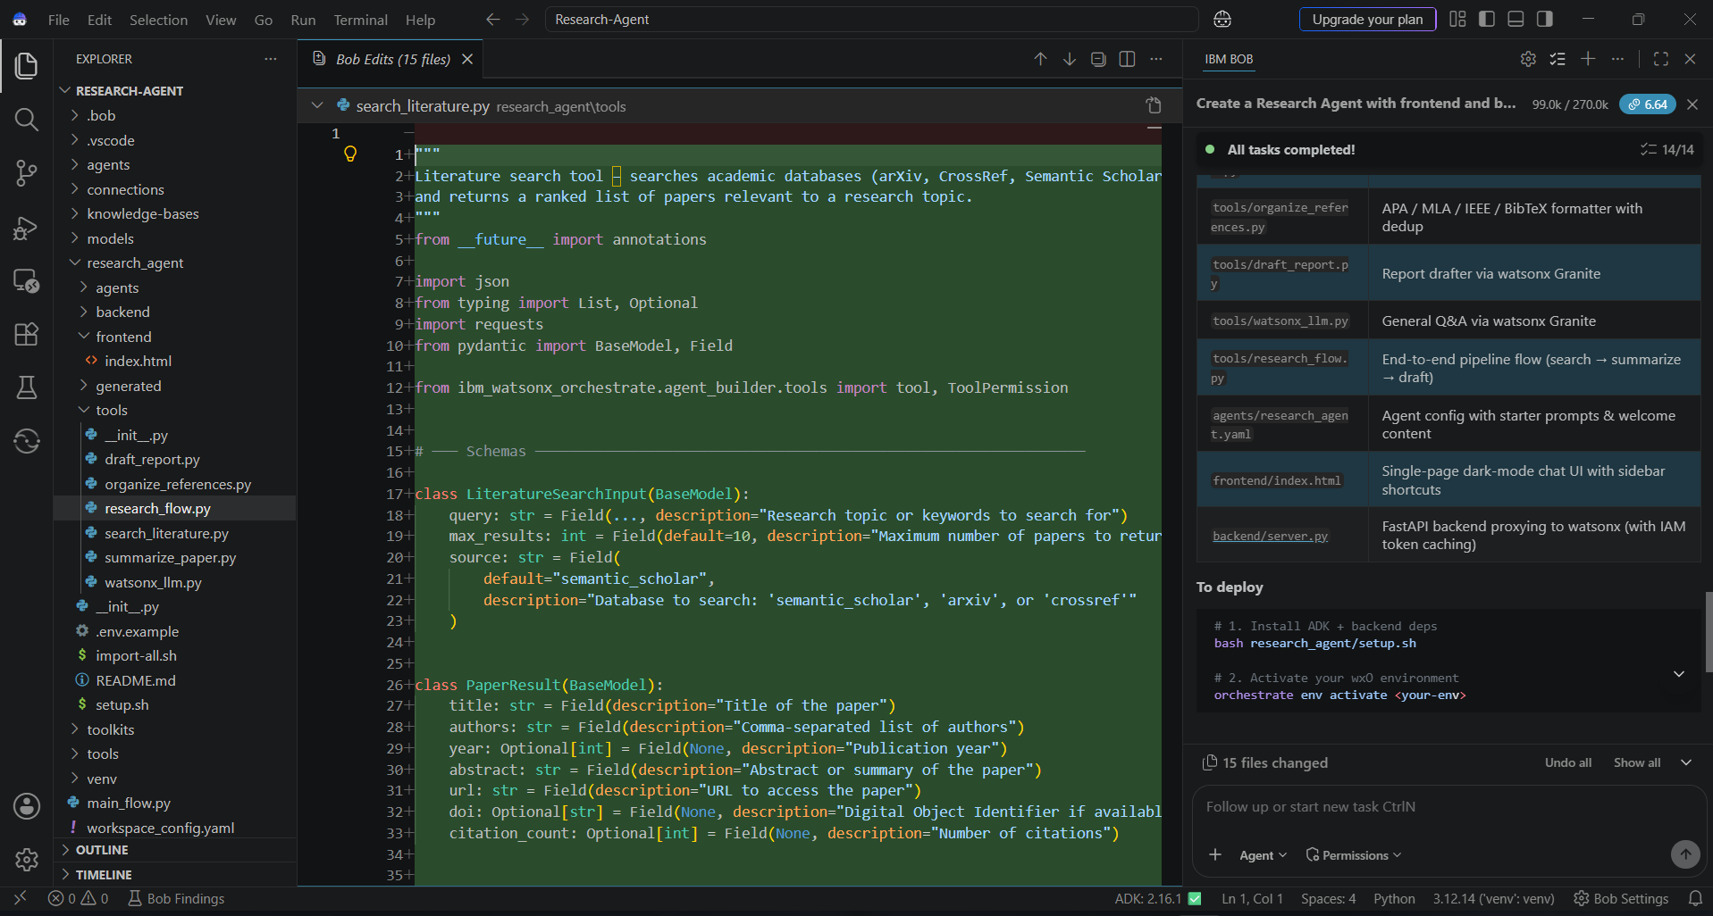
Required Files created using IBM bob -

Slide 7
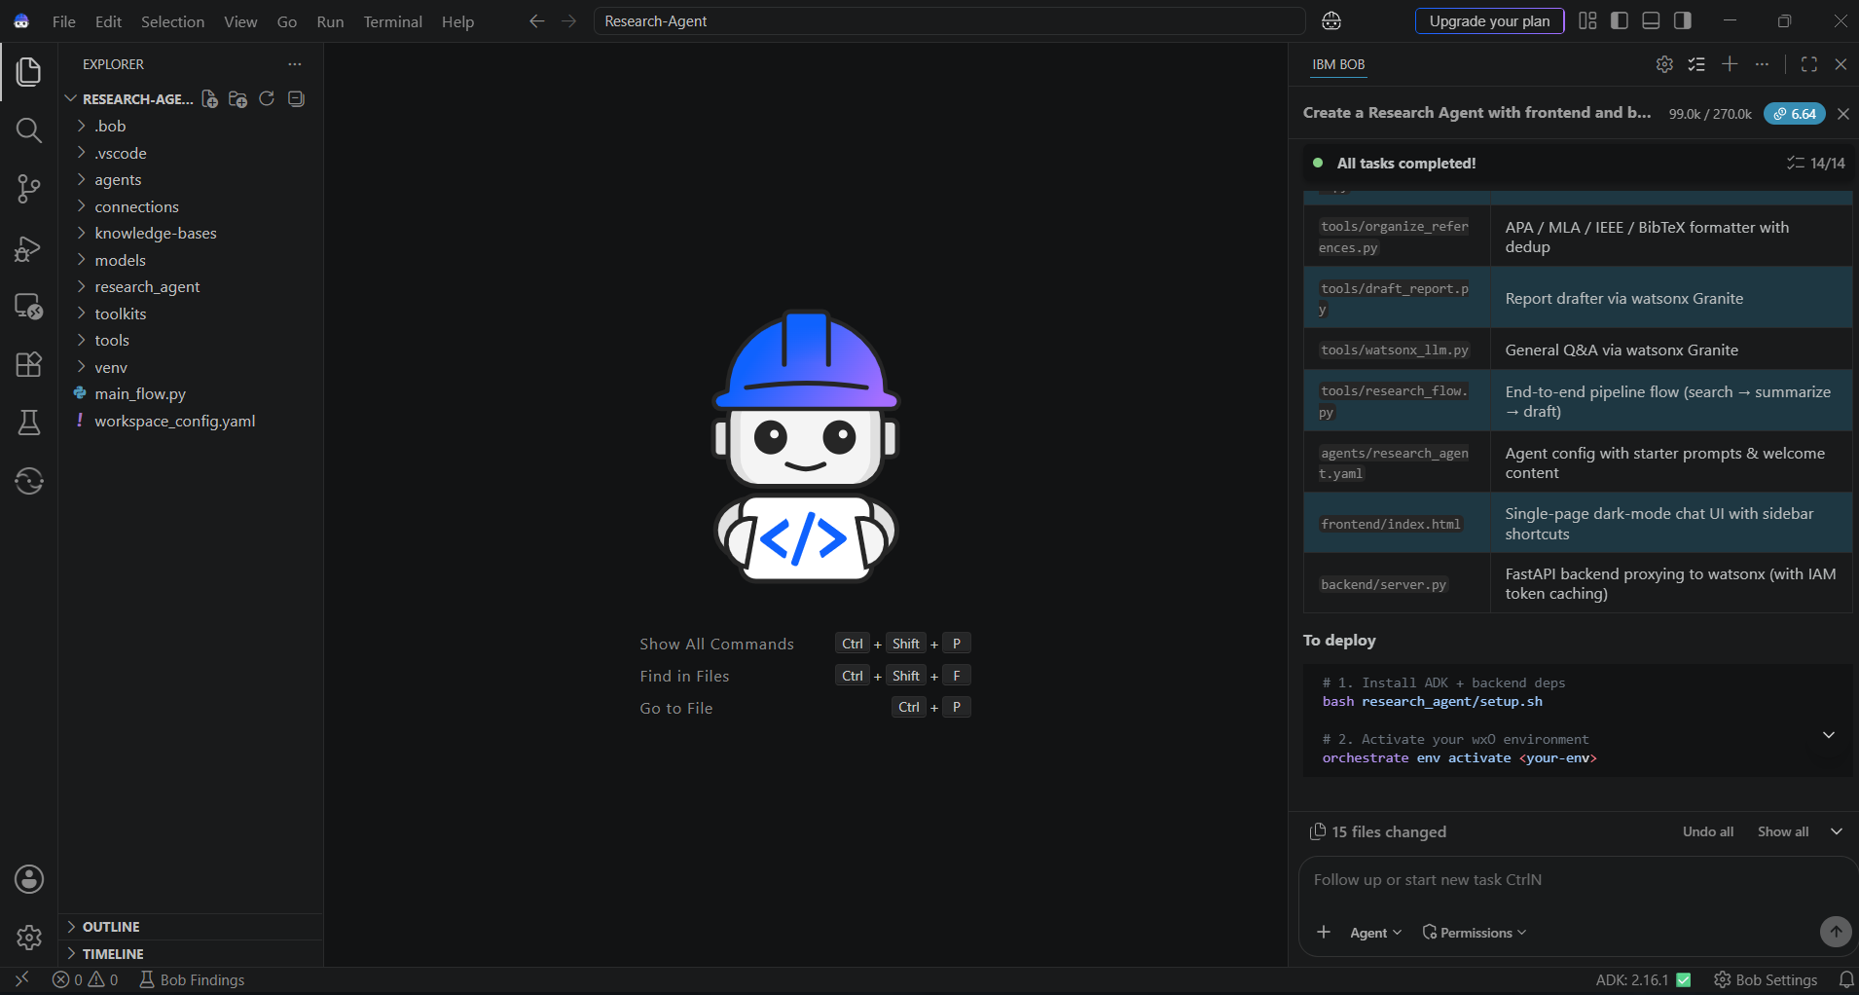
IBM Bob Screenshots:

Slide 8
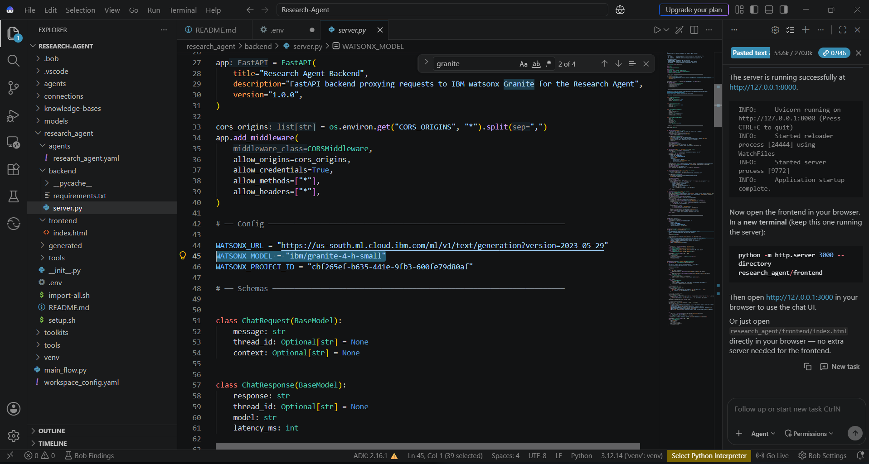

Slide 9
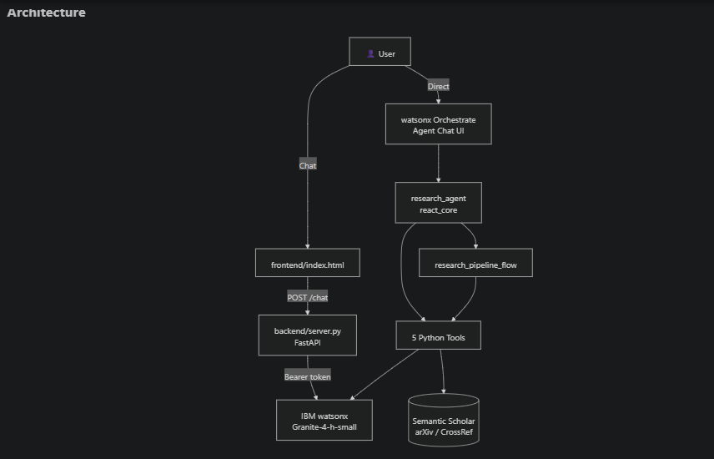
Architecture blueprint for IBM bob:

Slide 10

Role of Agentic AI in the solution
When a user says "Research transformer architectures in NLP and write a report", the agent does not ask for clarification or wait for step-by-step instructions. It independently decomposes the goal into subtasks:
Identify the right tool (research_pipeline_flow for a full pipeline request)
Determine search parameters (query, database, result count)
Decide summarization depth per paper
Select reference format (defaulting to APA)
Draft and structure the final report
This autonomous decomposition is the defining characteristic of an agentic system, separating it from a simple tool-calling API

Slide 11


Token Usage
11,761 token are used
Before Prompt
After the Prompt
·
·
·

Slide 12
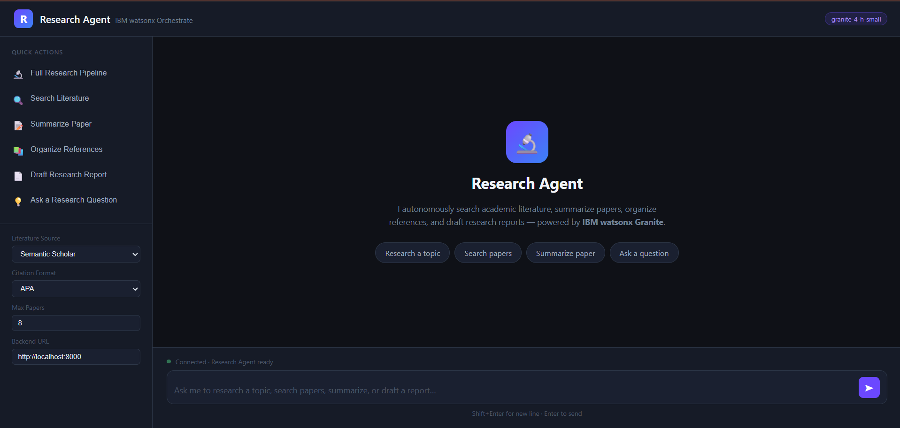
Project Output Screenshot
Please put IBM Bob output screenshots with 2-3 prompts.
You can take 2-3 more slides for each screenshot
·
·
·

Slide 13
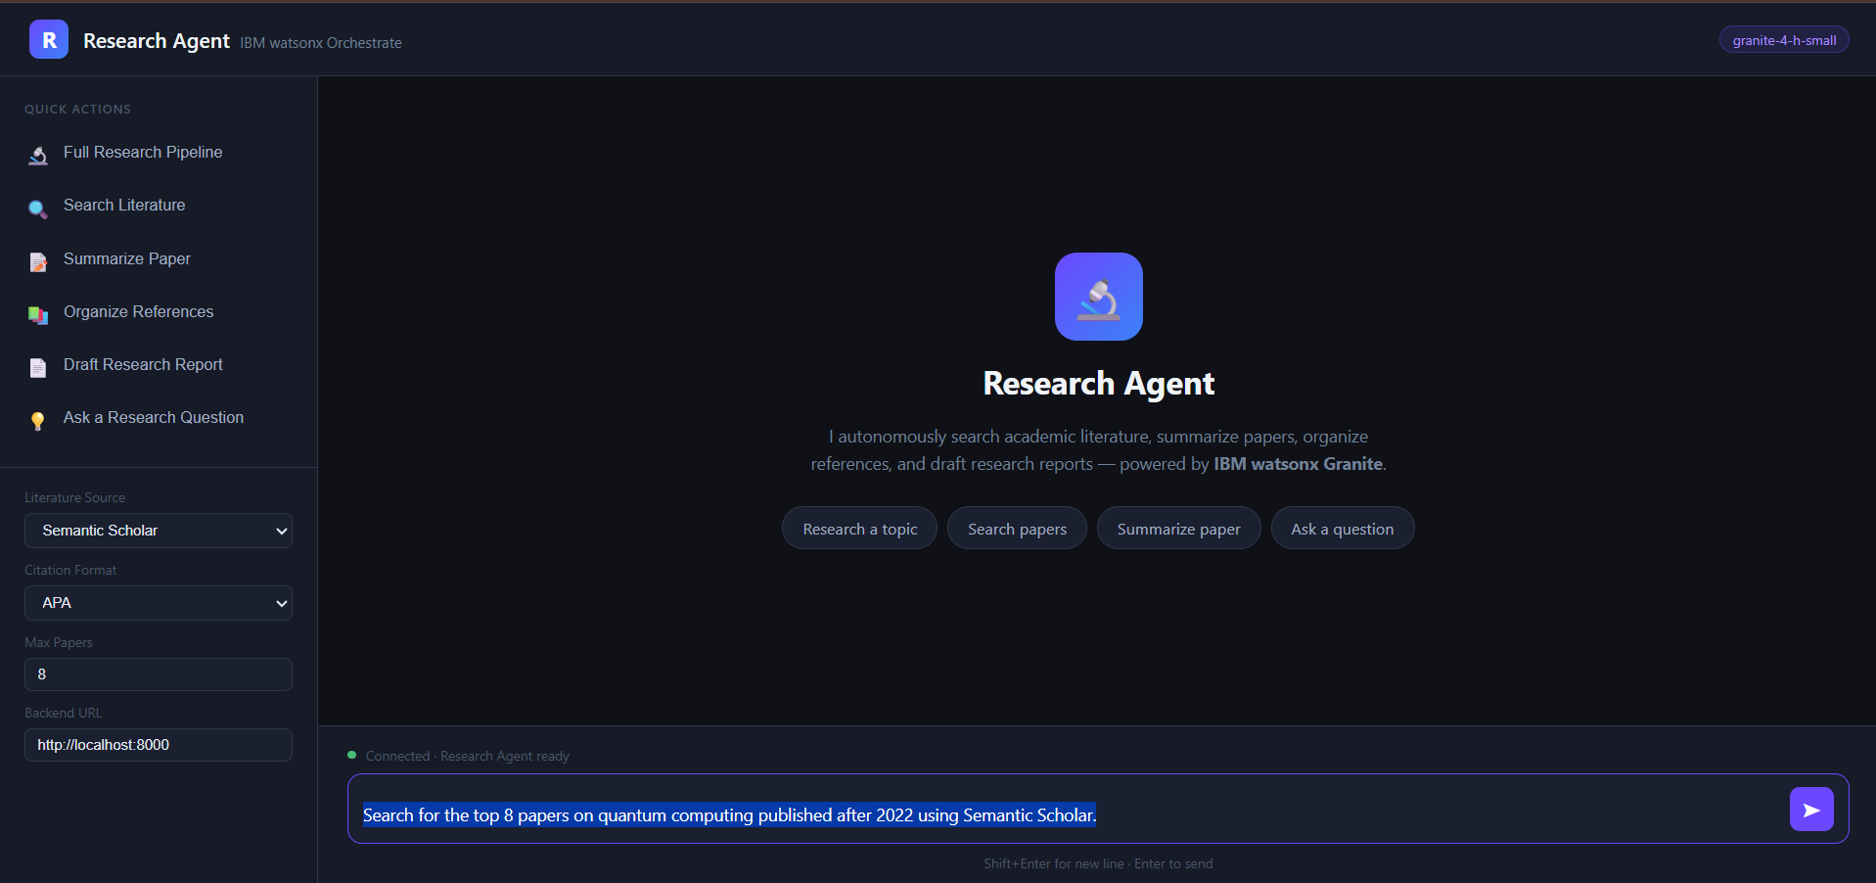
Project Output Screenshot
Please put IBM Bob output screenshots with 2-3 prompts.
You can take 2-3 more slides for each screenshot
·
·
·

Slide 14
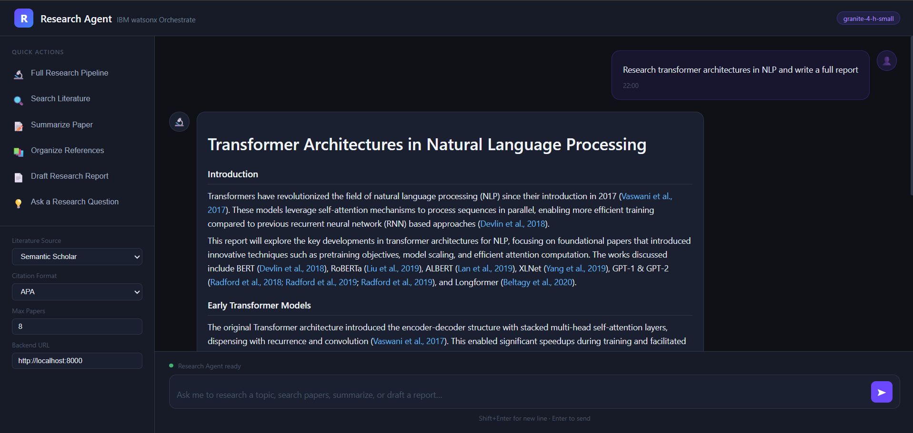
Project Output Screenshot
Please put IBM Bob output screenshots with 2-3 prompts.
You can take 2-3 more slides for each screenshot
·
·
·

Slide 15
Novelty and Uniqueness
The Research Agent stands apart from conventional literature search tools and generic AI chatbots through a combination of architectural decisions and capabilities that, taken together, form a system with no direct off-the-shelf equivalent.
Fully Autonomous End-to-End R&D Pipeline: Unlike tools such as Google Scholar or Semantic Scholar that stop at search, this system executes a complete research pipeline in a single agent invocation — search → per-paper summarization → reference formatting → full report drafting.
Multi-Database Federated Search in One Query: The agent is capable of simultaneously targeting three independent academic databases — Semantic Scholar, arXiv, and CrossRef — each with its own API protocol (REST/JSON, Atom/XML, and CrossRef Works respectively).
IBM Watsonx Granite as the Reasoning Core: Rather than relying on commercial third-party models, the system is powered by IBM watsonx Granite (ibm/granite-4-h-small) — an enterprise-grade, governance-ready LLM.
Citation-Aware Structured Summarization: The summarize_paper tool does not produce a generic paragraph summary. It extracts structured fields — key contributions, methodology, conclusions, and a one-liner — that are then consumed as typed inputs by the report drafting tool.

Slide 16
Git Hub Link
Github URL – https://github.com/vivek-kr011/Research-Agent
Make sure you have Uploaded following three files into your github repository
1) All Agent relevant files of IBM Cloud , 2) yourproblemstatement.pdf file 3) your projectpresntation.pptx file 4)any other files
·
·
·

Slide 17
Future Scope
1. Multi-Source Database Expansion & Real-Time Indexing
Currently the agent searches Semantic Scholar, arXiv, and CrossRef. Future versions can integrate additional databases such as PubMed (biomedical), IEEE Xplore (engineering), Scopus, and Google Scholar. Alongside this, a real-time indexing pipeline can be built so newly published preprints are automatically ingested and available for search without manual re-querying, keeping research outputs up-to-date with the latest literature.
2. Persistent Research Workspace & Session Memory
The current system is stateless — each request starts fresh. Introducing a persistent research workspace would allow users to save ongoing research sessions, accumulate paper collections across multiple queries, and revisit or extend previous reports. This can be backed by a vector database (e.g., Chroma or Pinecone) that stores embeddings of already-summarized papers, enabling semantic deduplication and incremental report building over time.
·
·
·

Slide 18
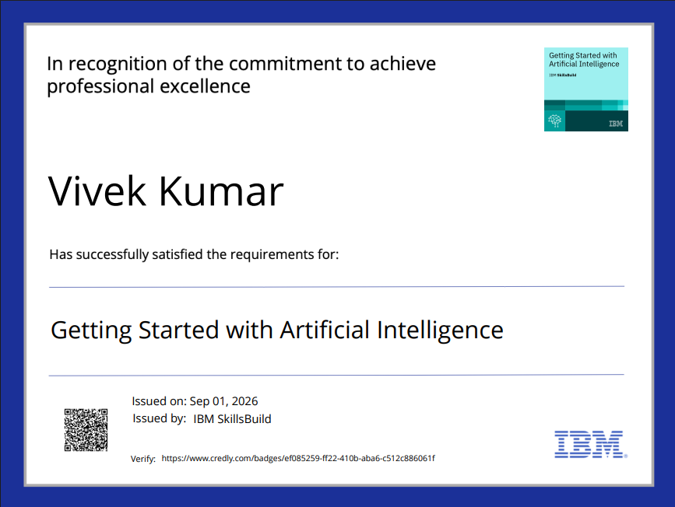
Certificates Earned:
Please add your credly certificate(Getting Started with Artificial Intelligence)

Slide 19
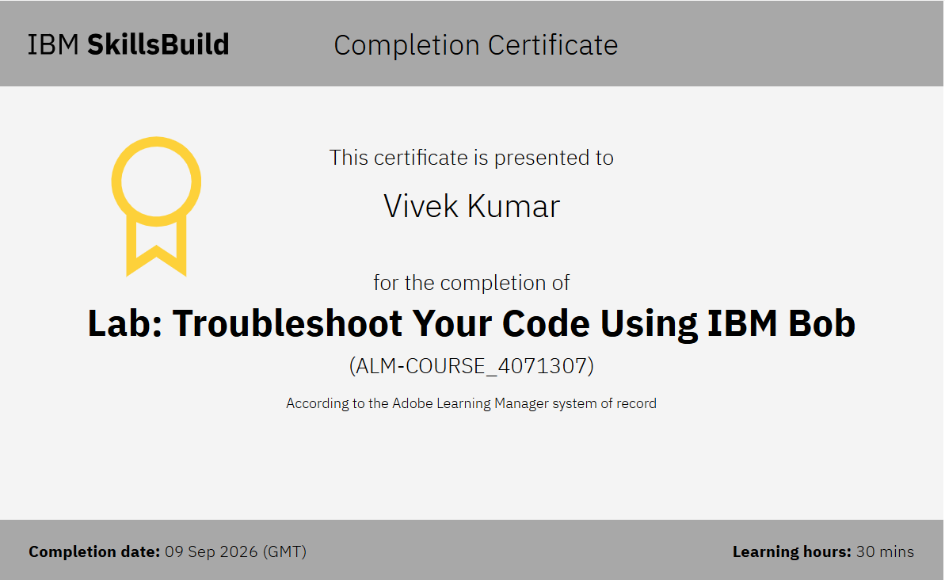
Certificates Earned:​
Add your IBM BOB Certificate

Slide 20


